Slide 1
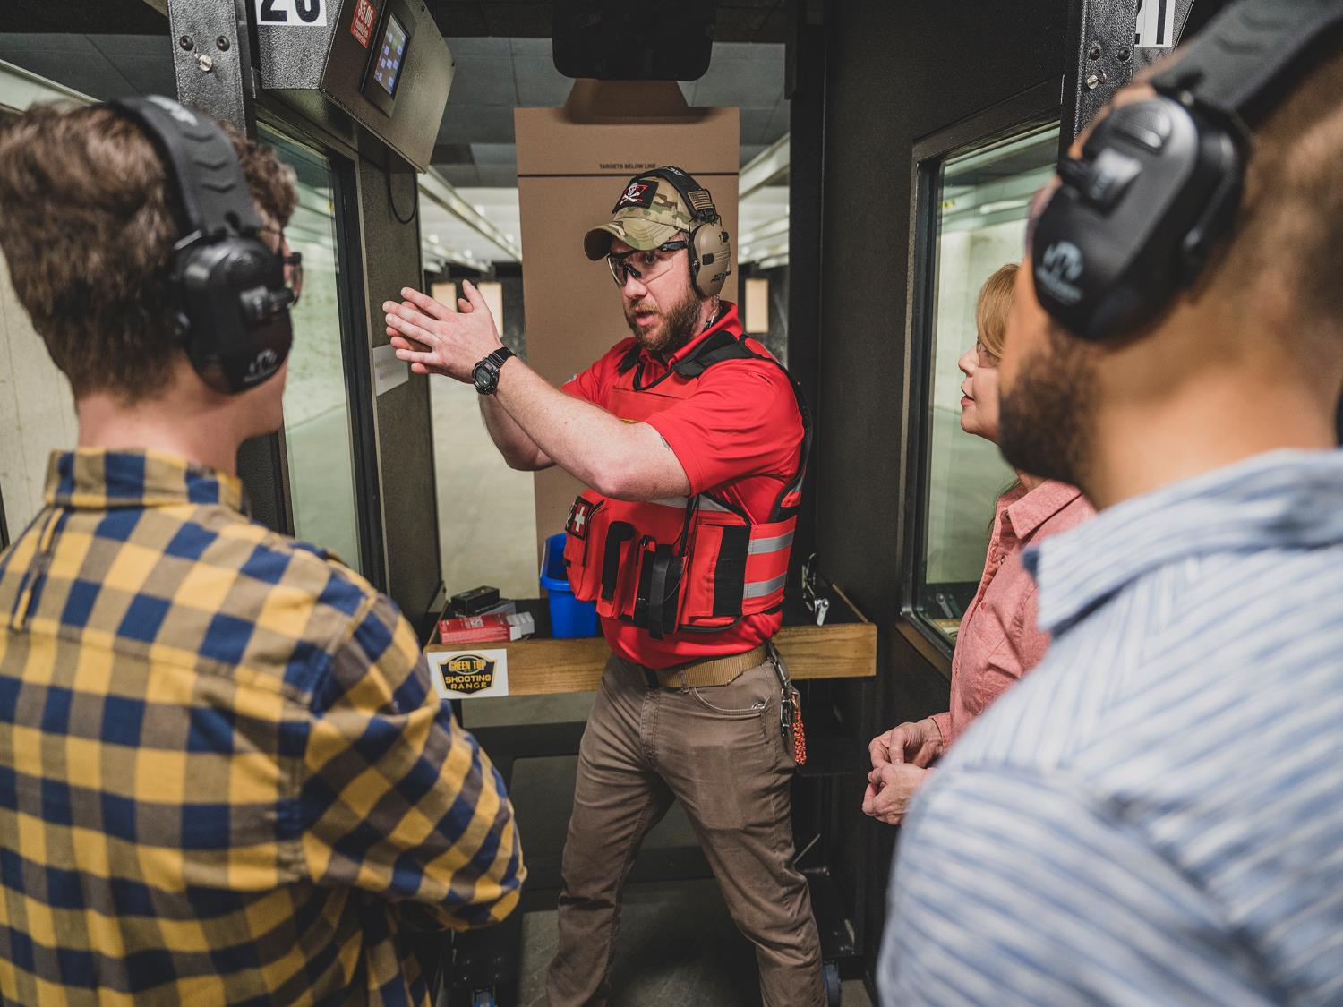
WELCOME NEW SHOOTERS! TACTICS TO WIN PARTICIPATION FROM UNDER-REPRESENTED COMMUNITIES
Conducted on behalf of Outdoor Stewards of Conservation Foundation by Southwick Associates and DJ Case & Associates

Slide 2
TABLE OF CONTENTS
Key Takeaways
Purpose
Methods
Participation Interest, Motivations, & Barriers
Interest Levels
Motivations
Barriers
Preferred Imagery & Messaging
Imagery Introduction
Shotgun
Handgun
Rifle (Traditional)
Modern Sporting Rifle
Associations
Range & Firearm Preferences
Promotions & Information
Services
Amenities
Second Amendment
For more Information
3
5
7
9
10
11
12
13
14
15
16
17
18
19
20
21
22
24
25
27

Slide 3
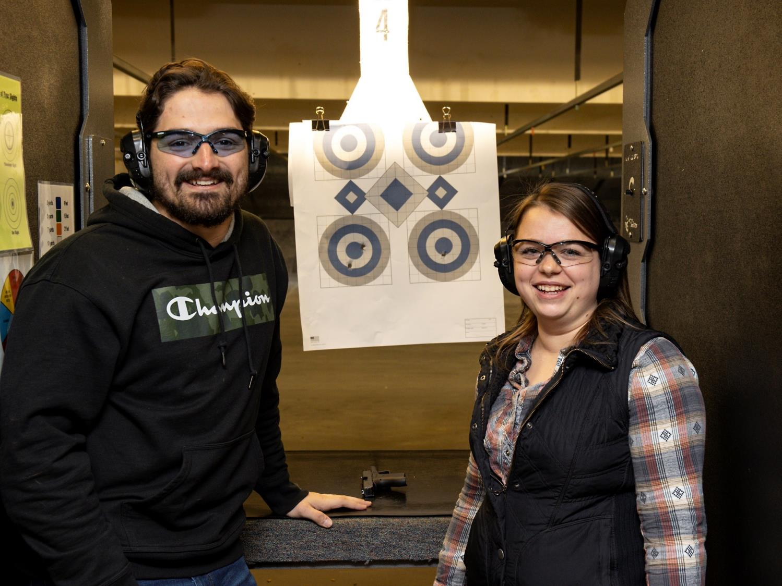
KEY TAKEAWAYS

Slide 4
KEY TAKEAWAYS
The pool of potential new range visitors is deep!
African-Americans = 61%, or 25.4 million nationally rated their interest a 4 or 5 out of 5.
Hispanics = 64%, or 39.7 million rated their interest a 4 or 5.
Asian Americans = 53%, or 10.4 million rated their interest a 4 or 5.
Altogether and given overlap in these groups, 73.0 million people from non-traditional audiences are interested in trying target shooting.
Interests, motivations, and preferences show strong similarities across the various tested demographic categories. Some differences do exist, such as by gender, and are available in the detailed companion spreadsheet.
All participants who were selected for this survey identified that they had never participated in target shooting with a firearm but indicated an interest in doing so.
Newcomers are focused on safety, protection, skill acquisition, and fun.
Safety is an underlying theme and concern of potential new shooters. They need to know everything expected of them and all safety measures that will be taken BEFORE they ever decide to visit a range. This point cannot be overstated!

Slide 5
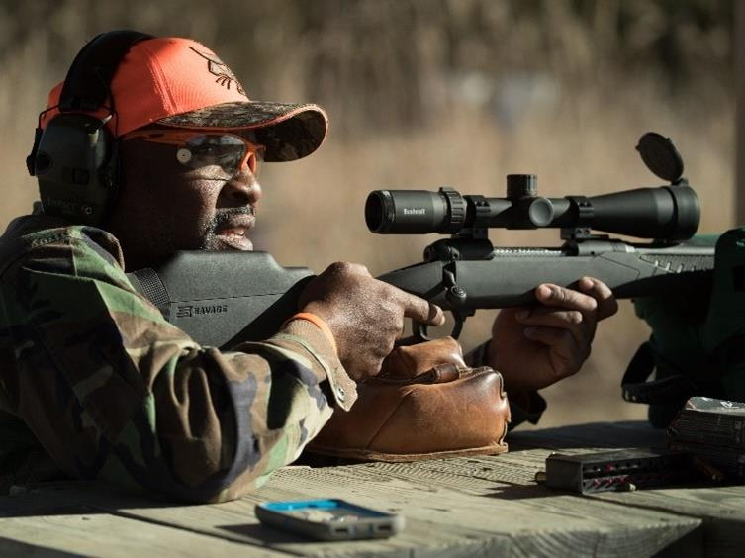
PURPOSE

Slide 6
PURPOSE
Welcome New Shooters! Tactics to Increase Participation within Under-Represented Communities
The Outdoor Stewards of Conservation Foundation led this project, assisted by research partners Southwick Associates and DJ Case & Associates, with the goal of identifying the need to learn more about the millions interested in trying target shooting for the first time.
Previous National Shooting Sports Foundation (NSSF) research (2015) showed women, Hispanics, African Americans, and Asian Americans have high rates of interest in target shooting. In fact, Hispanics and African Americans had higher levels of interest (26% and 27%, respectively) than Asians (15%) and Caucasians (13%), while women had the same interest levels as men. However, multiple sources show even after the recent spikes in participation since 2020, shooting sports participation still remains overwhelmingly male and Caucasian. Considering that a majority of the U.S. population is expected to be non-Caucasian by mid-century, there is significant need and potential to grow target shooting. This project sought to identify the barriers holding back under-represented audiences from trying target shooting and potential solutions.
This project conducted focus groups followed by surveys of each audience described above to quantify their interest in target shooting; the types of shooting activities of most interest; the types of ranges where they would be most comfortable; the types of promotions, services, and amenities that would increase the likelihood of them visiting; and how to best reach them with information on where to shoot, requirements, and other information they are currently lacking but need in order to make the decision to visit a range. Identical information was produced for Caucasians for comparison purposes. The results will help state agencies, public and private ranges, and organizations working on behalf of target shooting to help them understand how to be more welcoming and accommodating towards segments of the US population that currently hesitate to participate in target shooting.

Slide 7
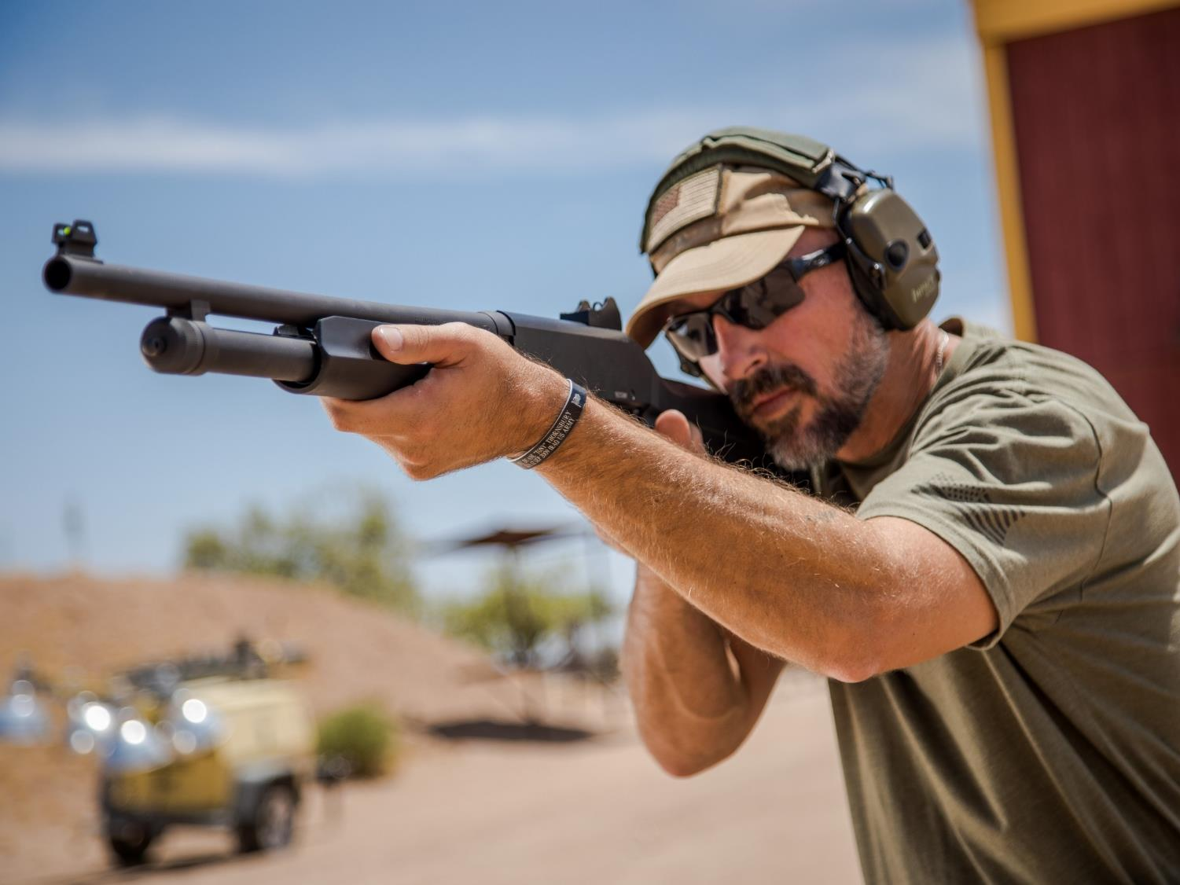
METHODS

Slide 8
METHODS​
Survey #1
Focus Groups
Target Audience​
U.S. residents, age 18 or older;
Who have never participated in target shooting with a firearm;
On a scale from one to five, indicated interest of three or higher in target shooting with a firearm
Ages 18 and older;
Never participated in target shooting with a firearm but indicated an interest in trying;
On a scale from one to ten, indicated interest of seven or higher in target shooting with a firearm;
Equally representing four US time zones: Eastern, Central, Mountain, and Pacific
Survey Run Dates
September 2 – 14, 2024
Session Dates
Response Groupings
May 1 – 8, 2024
The study yielded 1,991 completed responses (some belong to more than one group):
1,069 Women
483 African Americans
395 Asian Americans
Logistics
922 Men
405 Hispanics
910 Caucasians
4 virtual online sessions
29 participants total
Survey #2
Representative sample of U.S. population fielded online November 21, 2024. N=384
Purpose: Determined the number of people interested in trying target shooting.

Slide 9
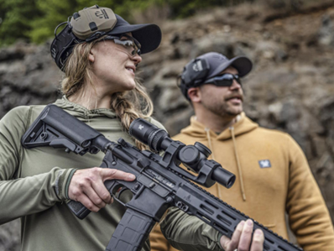
PARTICIPATION INTEREST, MOTIVATIONS, & BARRIERS

Slide 10
Interest Levels
The pool of potential new range visitors is deep!
55% to 66% of people from all major communities indicate moderate to high levels of interest in trying target shooting with a firearm.

Slide 11
Motivations
Across all groups (gender, age, ethnicity, community), the most common reasons for wanting to try target shooting include:
Wanting to be able to protect themselves and their families
Learning how to handle firearms safely
Developing a new skill
The challenge of being able to hit a target
It looks fun, exciting, thrilling
Some notable differences were noticed:
Learning how to safely handle a firearm rated lower in rural areas versus other communities.
Compared to men, women were more interested in learning how to safely handle firearms, learning something new and protection themes. Men show greater interest in the fun and excitement themes.
Within each gender, reasons for their interest and motivations vary little by race, ethnicity and where they live.
Other slight differences were noted by age. Please see the accompanying spreadsheet for detailed results and differences.
KEY! Focus groups showed “recreation” and “fun” themes frequently emerged in discussions about target shooting, indicating a need to convey that target shooting – no matter peoples’ specific motivations – is enjoyable! Deliver your focused promotions with a touch of fun and recreation.
100%
90%
69%
58%
55%
35%
33%
25%
24%
17%
17%
16%
12%

Slide 12
Barriers
Please note that all findings in this report relate to people who are interested in target shooting but have hesitated to participate. These results are meant to support these people in their decision to do so.
The top barrier reported to trying shooting sports was not owning a firearm.
With loaners and rentals, this should make for attractive promotions for range owners.
The next most-cited barriers include:
Perceptions that target shooting is expensive.
Not knowing which type of firearm to try.
Not sure if it’s safe. Be sure to promote that safety is expected and enforced at all times.
No one to go with. Consider ‘2 for 1’ incentives to bring a friend, plus beginners’ events.
From the qualitative discussions, top barriers also include:
Lack of knowledge / not understanding what the experience will be like, what’s expected.
Not knowing where to go.
Concerns about costs.
Lack of time (which suggests they are prioritizing activities they understand).
Nervousness surrounding firearms.
Worry about making mistakes and wanting to lean heavily on instructors to guide them through the process until they gained more confidence.
Discussion & Recommendations: Potential new shooters will not decide to visit a range until these concerns are resolved. Be sure to promote your range and the sport as welcoming, safe and ready to assist with questions before being taken to the firing line. Their safety concerns relate not just to their personal safety, but they want to know they will not be a danger to others. Explain safety requirements and measures taken. Show images of beginners like them at the range.
12

Slide 13
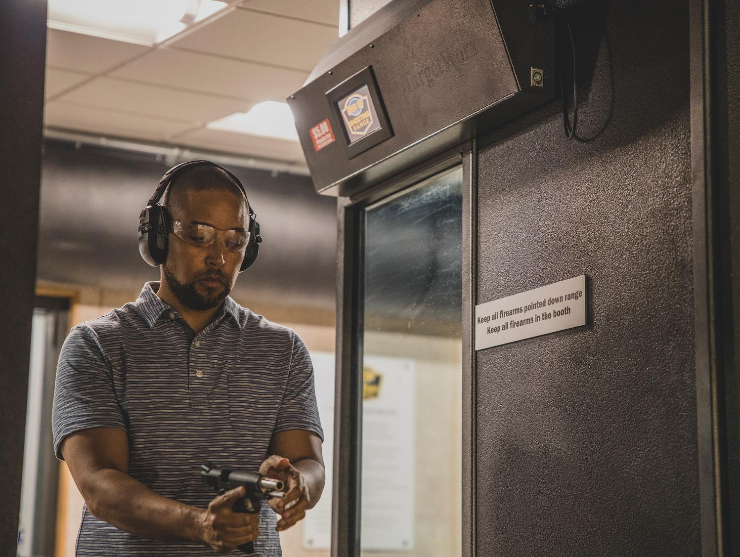
PREFERRED IMAGERY & MESSAGING

Slide 14
Imagery Introduction
The photo rankings that follow were based on “Most to Least Preferred.”
Participants were also asked to rank the images from Strongly Agree to Strongly Disagree for these four statements
Looks fun
Looks safe
Looks welcoming
Teaching me to protect myself, my family, and home
Although we didn’t survey for specific elements in each image (e.g., smiling faces, number of people, ethnicity, gender), ‘image associations’ help us identify when multiple elements come together to create better photos. We highlight these where applicable.
Other studies support some of the findings we include in this report:
Increasing Hunting and Shooting Mentor and Mentee Numbers and Effectiveness, Multi-State Conservation Grant # F20AP11912, May 12, 2021
Small Game Diversity & Inclusion Marketing Toolkit and Focus Group Report, Multi-State Conservation Grant # F21AP00240-01 December 2021
The Missing Link in R3: Making Mentorship Work, Multi-State Conservation Grant # F19AP00111
Further details available in the accompanying EXCEL™ results file
100%
90%
69%
58%
55%
35%
33%
25%
24%
17%
17%
12%

Slide 15
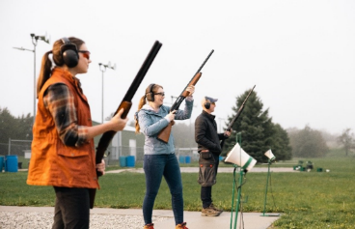
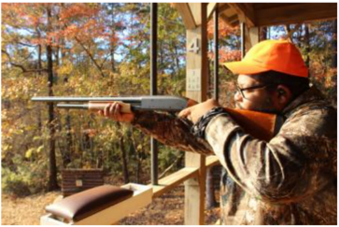
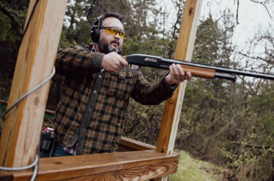
Preferred Imagery - Shotgun
Most preferred
Second-most preferred
Least preferred
100%
90%
69%
58%
Potential reasons why the most preferred shotgun photo was selected:
This photo suggests a safe, controlled shooting environment: Guns are up, and they are using safety gear (ear and eye protection).
Positive facial expressions are a top-level association. Smiles appear in this image but not in the other two.
Both the most preferred and second-most preferred images exemplify diversity. Other research shows that photos regarded as compelling by non-white audiences often show a mix of races and ethnicity.
Further details available in the accompanying EXCEL™ results file
55%
35%
33%
25%
24%
17%
17%
12%

Slide 16
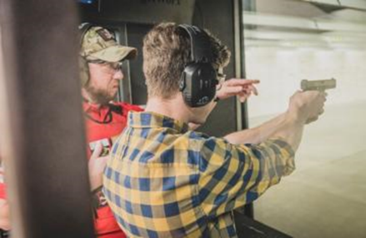
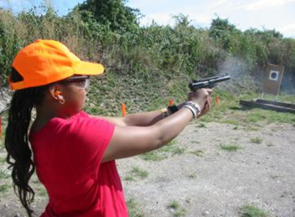
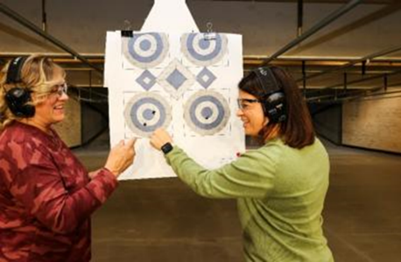
Preferred Imagery - Handgun
Most preferred
Second-most preferred
Least preferred
100%
90%
69%
58%
Potential reasons why the most preferred handgun photo was selected:
It suggests a safe, controlled environment, monitored by an expert who provides instruction to a beginner. To beginners, this may indicate a welcoming environment.
The two other photos do not contain a clearly identified expert on hand.
The use of a firearm is depicted, which is missing in the photo of women looking at a target.
It was highly rated across all groups as portraying “teaching me to protect myself, my family, and home.”
Key Takeaway: A photo with all white males may work if basic themes like safety, expert guidance, and a welcoming environment are emphasized. But this photo might have rated even higher if one of the individuals were not a white male, a point seen in other research.
Further details available in the accompanying EXCEL™ results file
55%
35%
33%
25%
24%
17%
17%
12%

Slide 17
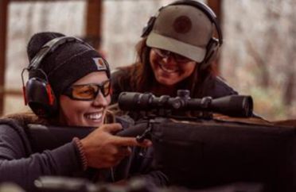
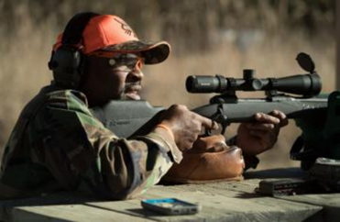
Preferred Imagery – Traditional Rifle
Most preferred
Second-most preferred
Least preferred
100%
90%
69%
58%
Potential reasons why the most preferred traditional rifle photo was selected:
It features women, an attribute found to be compelling in other studies.
The smiles on both people’s faces convey fun.
The image suggests expert instruction and guidance, contributing to the impression of a safe and welcoming environment.
Key Takeaway: This image was overwhelmingly preferred, with nearly three-quarters of all respondents selecting this image. It may be difficult to improve on this picture when promoting the opportunity to try target shooting with a traditional rifle.
Further details available in the accompanying EXCEL™ results file
55%
35%
33%
25%
24%
17%
17%
12%

Slide 18
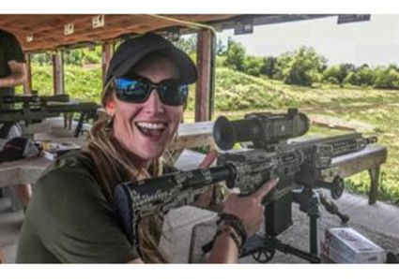
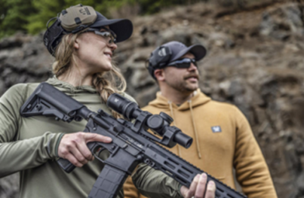
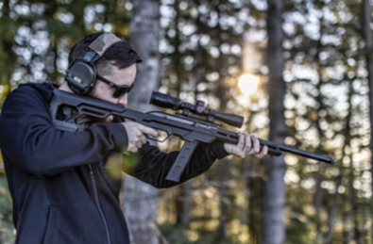
Preferred Imagery – Modern Sporting Rifle
Tied as most-preferred
Tied as most-preferred
Least preferred
100%
90%
69%
58%
Survey respondents were evenly divided between the first two photos.
Both may convey fun (smiling faces) in a controlled environment: a bench at a range in the first image, and the presence of a potential expert in the second.
Older, white, and rural respondents skewed toward the first photo of the single female.
Younger people, non-white participants, and people in small towns preferred the photo showing the couple.
In general, the third photo scored less welcoming than the other two, but only slightly. Rural respondents rated all three images as equally welcoming.
Further details available in the accompanying EXCEL™ results file
55%
35%
33%
25%
24%
17%
17%
12%

Slide 19
Associations
‘Associations’ are when one or more photos are shown to rate strongly together. These photos can be used together within promotions to build extra rapport with the target audience.
Top-level associations seen in the photos include:
Those that show more than one person.
One of the photos will show positive facial expressions.
At least one of all the association combinations features a woman.
None of the most associated photos are exclusively of men, indicating that a mix of genders will result in a better response from the new shooter demographic.
100%
90%
69%
58%
55%
35%
33%
25%
24%
17%
17%
16%
12%

Slide 20
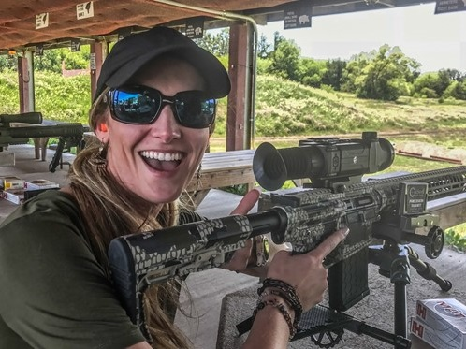
RANGE & FIREARM PREFERENCES

Slide 21
Information
Strategies to attract new shooters before they ever set foot on your range:
Promote safety and beginner support in all communications, including rules and procedures to ensure safety and special staffing, events, equipment, instructions, promotions and other resources available to beginners.
Potential new shooters need to know what to expect and what’s expected of new and experienced shooters BEFORE they will decide to visit a range.
Search engines like Google and Bing were selected by all audiences as the number one source of information when researching ranges to visit, followed by friends/family/word of mouth.
When asked what information they would like to know about a range BEFORE visiting, six topics emerged. Be sure to address these in your promotions:
Safety standards and practices
Are they welcoming and supportive towards beginners?
Are expert advisors or instructors available?
Are firearms, safety gear, and ammunition available for rent/purchase?
The types of target shooting activities offered (handgun, airgun, rifle, interactive vs. paper targets)
Is the range indoors or outdoors?

Slide 22
Promotions
Every demographic group chose “A beginner deal that includes everything I'll need” or “A special beginner event for first-time shooters only” as their top two most preferred promotions that might encourage them to visit a range.
Offer incentives for your new customers to return with a friend and motivate them to talk positively about their first-time experience at your range.
Host special range days for beginners and two-for-one specials to bring friends and family along.
Prospective target shooters prefer events geared towards beginners with trained staff to guide them for two main reasons:
Feeling intimidated by experienced shooters, concerned about not knowing other shooters at the range and wanting their first experiences to be among other beginners.
The preference for a safe, controlled environment monitored by experts.
Focus on people living within a 30-minute drive: this is the preferred amount of time respondents were willing to drive.
Like everyone else, beginners prefer to visit a range on weekends before 5pm. Plan accordingly!
Previous research into target shooting mentoring indicated having a diverse crowd in your advertising appeals to non-traditional audiences. Advertisements do not need show any specific mix of race, age, or ethnicity, but just enough diversity to convey the idea your range welcomes people beyond the traditional white male audience.

Slide 23
Services
Safety-themed services were the most preferred.
Safe, beginner-focused instruction was the top desired range service.
Concerns included having safety gear, appropriate beginner firearms, safety personnel and instruction for first-timers.
Most-preferred promotion was free safety gear.
None of the tested audiences ranked "multilingual instruction" among their top-desired service offerings.
Qualitative feedback consistently showed services and promotions that emphasized safety, professionalism, and expert/trained staff would capture their attention.
As mentioned earlier, consider range days geared towards beginner shooters with trained staff to guide them.
New shooters are intimidated by experienced shooters and prefer their first experiences to be among beginners like themselves.
New shooters desire training that is controlled and facilitated by experts.
Ensure safety is a top priority in all aspects of their visit, including the messaging heard before they decide to visit.

Slide 24
Amenities
Amenities aimed at newcomers should emphasize and reinforce safety! 75-85% of respondents indicated safety-focused amenities are very important, such as:
monitoring by safety experts,
qualified instructors, and
that the range is accredited or certified as safe and professional by a qualified shooting organization.
Over 80% of every group indicated wanting to try a handgun during their range visit.
88% or more of every segment surveyed would prefer to visit a staffed range over an unstaffed one.
As with all content of this report, please see the accompanying EXCEL file for greater details and breakouts across various demographics.
24

Slide 25
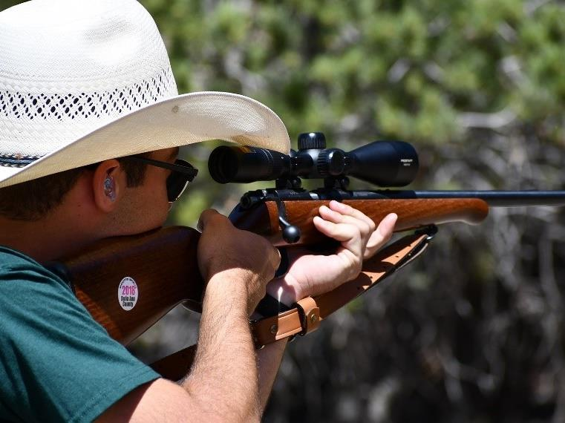
2ND AMENDMENT AWARENESS
25

Slide 26
2nd Amendment Awareness
Among potentially interested new target shooters:
Women were slightly less likely to recognize American citizens have a Constitutional right to legally own firearms guaranteed by the 2nd Amendment.
Males, whites, 55+ year-olds, and rural residents were more informed about the constitutional right to own firearms.
Females, 18-54-year-olds, Asian Americans, and urbanites were less informed.
By community, rural residents are more aware that a constitutional right to legally own firearms exists but are less able to identify the Second Amendment as the source of this right.
26

Slide 27
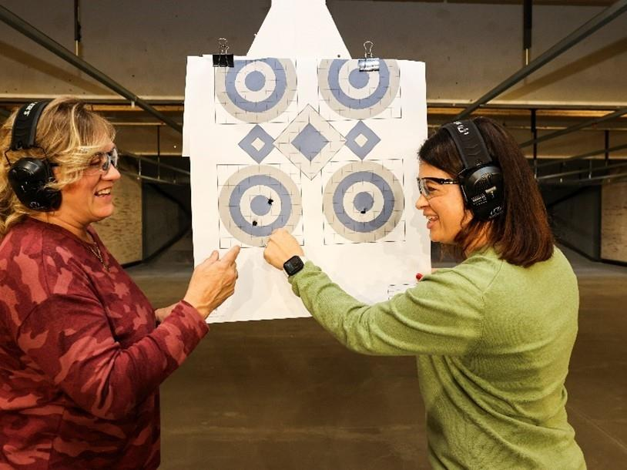
For detailed results, visit:
www.outdoorstewards.org, then Research & Resources, then
Target Shooting
27

